Slide 1



Chapter
2
Descriptive Statistics
© 2012 Pearson Education, Inc.
All rights reserved.
<number> of 149

Slide 2
Chapter Outline
2.1 Frequency Distributions and Their Graphs
© 2012 Pearson Education, Inc. All rights reserved.
<number> of 149

Slide 3
Section 2.1
Frequency Distributions
and Their Graphs
© 2012 Pearson Education, Inc. All rights reserved.
<number> of 149

Slide 4
Section 2.1 Objectives
Construct frequency distributions
Construct frequency histograms, frequency polygons, relative frequency histograms, and ogives
© 2012 Pearson Education, Inc. All rights reserved.
<number> of 149

Slide 5
Frequency Distribution
Frequency Distribution
A table that shows classes or intervals of data with a count of the number of entries in each class.
The frequency, f, of a class is the number of data entries in the class.
Class | Frequency, f
1–5 | 5
6–10 | 8
11–15 | 6
16–20 | 8
21–25 | 5
26–30 | 4
Class width 6 – 1 = 5
Lower class
limits
Upper class
limits
© 2012 Pearson Education, Inc. All rights reserved.
<number> of 149

Slide 6
Constructing a Frequency Distribution
Decide on the number of classes.
  Usually between 5 and 20; otherwise, it may be difficult to detect any patterns.
Find the class width.
  Determine the range of the data.
  Divide the range by the number of classes.
  Round up to the next convenient number.
© 2012 Pearson Education, Inc. All rights reserved.
<number> of 149

Slide 7
Constructing a Frequency Distribution
Find the class limits.
  You can use the minimum data entry as the lower limit of the first class.
  Find the remaining lower limits (add the class width to the lower limit of the preceding class).
  Find the upper limit of the first class. Remember that classes cannot overlap.
  Find the remaining upper class limits.
© 2012 Pearson Education, Inc. All rights reserved.
<number> of 149

Slide 8
Constructing a Frequency Distribution
Make a tally mark for each data entry in the row of the appropriate class.
Count the tally marks to find the total frequency f for each class.
© 2012 Pearson Education, Inc. All rights reserved.
<number> of 149

Slide 9
Example: Constructing a Frequency Distribution
The following sample data set lists the prices (in dollars) of 30 portable global positioning system (GPS) navigators. Construct a frequency distribution that has seven classes.
90 130 400 200 350 70 325 250 150 250
275 270 150 130 59 200 160 450 300 130
220 100 200 400 200 250 95 180 170 150
© 2012 Pearson Education, Inc. All rights reserved.
<number> of 149

Slide 10

Solution: Constructing a Frequency Distribution
90 130 400 200 350 70 325 250 150 250
275 270 150 130 59 200 160 450 300 130
220 100 200 400 200 250 95 180 170 150
Number of classes = 7 (given)
Find the class width
Round up to 56
© 2012 Pearson Education, Inc. All rights reserved.
<number> of 149

Slide 11
Solution: Constructing a Frequency Distribution
Use 59 (minimum value) as first lower limit. Add the class width of 56 to get the lower limit of the next class.
59 + 56 = 115
Find the remaining lower limits.
Lower limit | Upper limit
59
115
171
227
283
339
395
Class width = 56
© 2012 Pearson Education, Inc. All rights reserved.
<number> of 149

Slide 12
Solution: Constructing a Frequency Distribution
The upper limit of the first class is 114 (one less than the lower limit of the second class).
Add the class width of 56 to get the upper limit of the next class.
114 + 56 = 170
Find the remaining upper limits.
Lower limit | Upper limit
59 | 114
115 | 170
171 | 226
227 | 282
283 | 338
339 | 394
395 | 450
Class width = 56
© 2012 Pearson Education, Inc. All rights reserved.
<number> of 149

Slide 13
Solution: Constructing a Frequency Distribution
Make a tally mark for each data entry in the row of the appropriate class.
Count the tally marks to find the total frequency f for each class.
Class | Tally | Frequency, f
59–114 | IIII | 5
115–170 | IIII III | 8
171–226 | IIII I | 6
227–282 | IIII | 5
283–338 | II | 2
339–394 | I | 1
395–450 | III | 3
© 2012 Pearson Education, Inc. All rights reserved.
<number> of 149

Slide 14
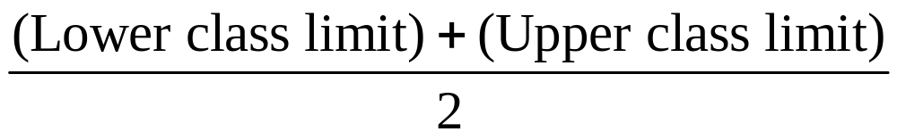
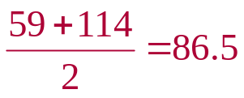
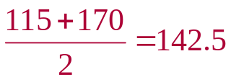
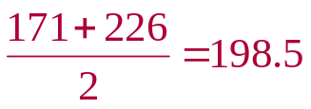
Determining the Midpoint
Midpoint of a class
Class | Midpoint | Frequency, f
59–114 |  | 5
115–170 |  | 8
171–226 |  | 6
Class width = 56
© 2012 Pearson Education, Inc. All rights reserved.
<number> of 149

Slide 15
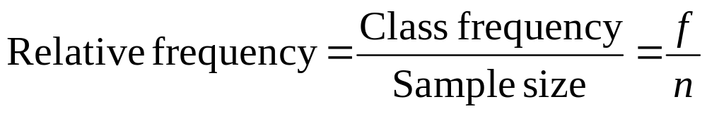
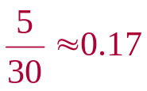
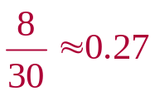
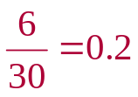
Determining the Relative Frequency
Relative Frequency of a class
Portion or percentage of the data that falls in a particular class.
Class | Frequency, f | Relative Frequency
59–114 | 5
115–170 | 8
171–226 | 6
© 2012 Pearson Education, Inc. All rights reserved.
<number> of 149

Slide 16
Determining the Cumulative Frequency
Cumulative frequency of a class
The sum of the frequencies for that class and all previous classes.
Class | Frequency, f | Cumulative frequency
59–114 | 5
115–170 | 8
171–226 | 6
5
+
13
+
19
© 2012 Pearson Education, Inc. All rights reserved.
<number> of 149

Slide 17
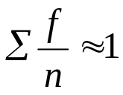
Expanded Frequency Distribution
Class | Frequency, f | Midpoint | Relative frequency | Cumulative frequency
59–114 | 5 | 86.5 | 0.17 | 5
115–170 | 8 | 142.5 | 0.27 | 13
171–226 | 6 | 198.5 | 0.2 | 19
227–282 | 5 | 254.5 | 0.17 | 24
283–338 | 2 | 310.5 | 0.07 | 26
339–394 | 1 | 366.5 | 0.03 | 27
395–450 | 3 | 422.5 | 0.1 | 30
Σf = 30
© 2012 Pearson Education, Inc. All rights reserved.
<number> of 149

Slide 18
Graphs of Frequency Distributions
Frequency Histogram
A bar graph that represents the frequency distribution.
The horizontal scale is quantitative and measures the data values.
The vertical scale measures the frequencies of the classes.
Consecutive bars must touch.
frequency
data values
© 2012 Pearson Education, Inc. All rights reserved.
<number> of 149

Slide 19
Class Boundaries
Class boundaries
The numbers that separate classes without forming gaps between them.
The distance from the upper limit of the first class to the lower limit of the second class is 115 – 114 = 1.
Half this distance is 0.5.
Class | Class boundaries | Frequency, f
59–114 |  | 5
115–170 |  | 8
171–226 |  | 6
58.5–114.5
First class lower boundary = 59 – 0.5 = 58.5
First class upper boundary = 114 + 0.5 = 114.5
© 2012 Pearson Education, Inc. All rights reserved.
<number> of 149

Slide 20
Class Boundaries
Class | Class boundaries | Frequency, f
59–114 | 58.5–114.5 | 5
115–170 | 114.5–170.5 | 8
171–226 | 170.5–226.5 | 6
227–282 | 226.5–282.5 | 5
283–338 | 282.5–338.5 | 2
339–394 | 338.5–394.5 | 1
395–450 | 394.5–450.5 | 3
© 2012 Pearson Education, Inc. All rights reserved.
<number> of 149

Slide 21
Example: Frequency Histogram
Construct a frequency histogram for the Global Positioning system (GPS) navigators.
Class | Class boundaries | Midpoint | Frequency, f
59–114 | 58.5–114.5 | 86.5 | 5
115–170 | 114.5–170.5 | 142.5 | 8
171–226 | 170.5–226.5 | 198.5 | 6
227–282 | 226.5–282.5 | 254.5 | 5
283–338 | 282.5–338.5 | 310.5 | 2
339–394 | 338.5–394.5 | 366.5 | 1
395–450 | 394.5–450.5 | 422.5 | 3
© 2012 Pearson Education, Inc. All rights reserved.
<number> of 149

Slide 22
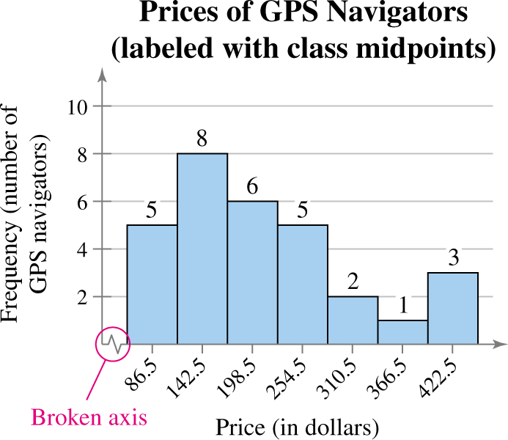
Solution: Frequency Histogram
(using Midpoints)
© 2012 Pearson Education, Inc. All rights reserved.
<number> of 149

Slide 23
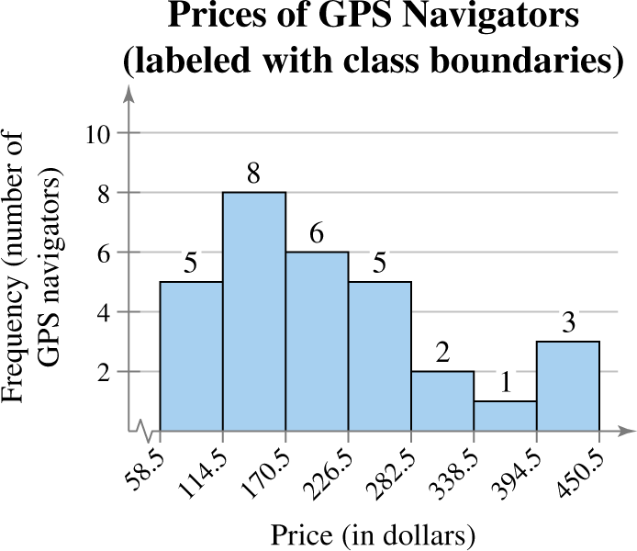
Solution: Frequency Histogram
(using class boundaries)
You can see that more than half of the GPS navigators are priced below $226.50.
© 2012 Pearson Education, Inc. All rights reserved.
<number> of 149

Slide 24
Graphs of Frequency Distributions
Frequency Polygon
A line graph that emphasizes the continuous change in frequencies.
frequency
data values
© 2012 Pearson Education, Inc. All rights reserved.
<number> of 149

Slide 25
Example: Frequency Polygon
Construct a frequency polygon for the GPS navigators frequency distribution.
Class | Midpoint | Frequency, f
59–114 | 86.5 | 5
115–170 | 142.5 | 8
171–226 | 198.5 | 6
227–282 | 254.5 | 5
283–338 | 310.5 | 2
339–394 | 366.5 | 1
395–450 | 422.5 | 3
© 2012 Pearson Education, Inc. All rights reserved.
<number> of 149

Slide 26
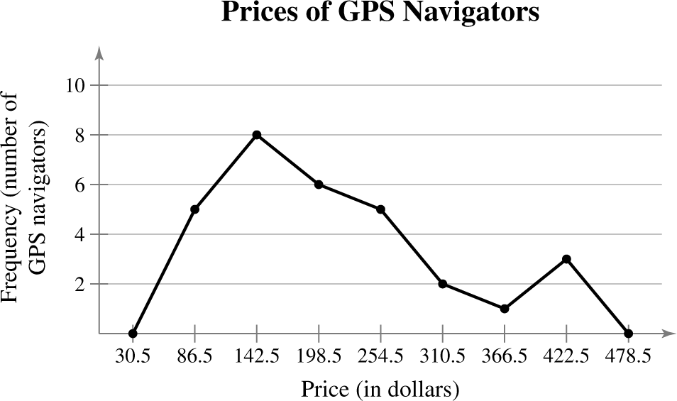
Solution: Frequency Polygon
The graph should begin and end on the horizontal axis, so extend the left side to one class width before the first class midpoint and extend the right side to one class width after the last class midpoint.
You can see that the frequency of GPS navigators increases up to $142.50 and then decreases.
© 2012 Pearson Education, Inc. All rights reserved.
<number> of 149

Slide 27
Graphs of Frequency Distributions
Relative Frequency Histogram
Has the same shape and the same horizontal scale as the corresponding frequency histogram.
The vertical scale measures the relative frequencies, not frequencies.
relative frequency
data values
© 2012 Pearson Education, Inc. All rights reserved.
<number> of 149

Slide 28
Example: Relative Frequency Histogram
Construct a relative frequency histogram for the GPS navigators frequency distribution.
Class | Class boundaries | Frequency, f | Relative frequency
59–114 | 58.5–114.5 | 5 | 0.17
115–170 | 114.5–170.5 | 8 | 0.27
171–226 | 170.5–226.5 | 6 | 0.2
227–282 | 226.5–282.5 | 5 | 0.17
283–338 | 282.5–338.5 | 2 | 0.07
339–394 | 338.5–394.5 | 1 | 0.03
395–450 | 394.5–450.5 | 3 | 0.1
© 2012 Pearson Education, Inc. All rights reserved.
<number> of 149

Slide 29
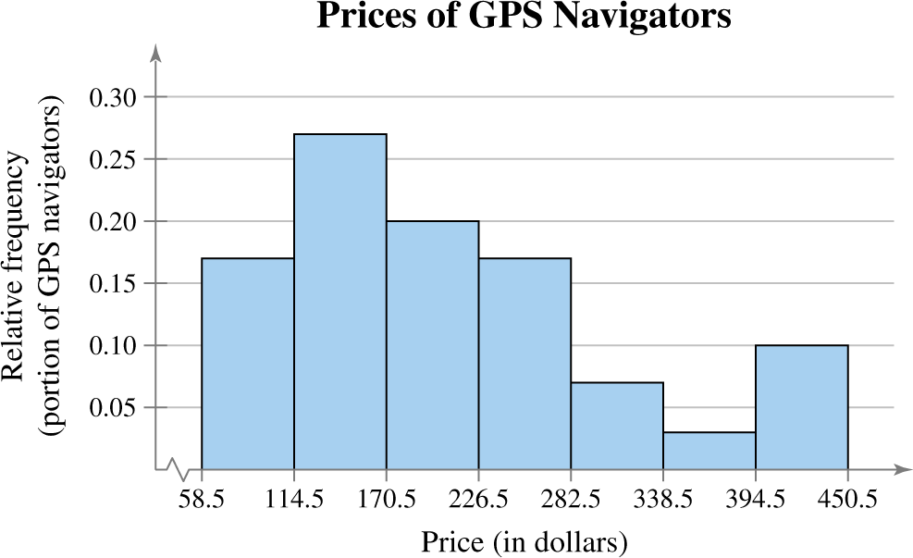
Solution: Relative Frequency Histogram
6.5 18.5 30.5 42.5 54.5 66.5 78.5 90.5
From this graph you can see that 27% of GPS navigators are priced between $114.50 and $170.50.
© 2012 Pearson Education, Inc. All rights reserved.
<number> of 149

Slide 30
Graphs of Frequency Distributions
Cumulative Frequency Graph or Ogive
A line graph that displays the cumulative frequency of each class at its upper class boundary.
The upper boundaries are marked on the horizontal axis.
The cumulative frequencies are marked on the vertical axis.
cumulative frequency
data values
© 2012 Pearson Education, Inc. All rights reserved.
<number> of 149

Slide 31
Constructing an Ogive
Construct a frequency distribution that includes cumulative frequencies as one of the columns.
Specify the horizontal and vertical scales.
  The horizontal scale consists of the upper class boundaries.
  The vertical scale measures cumulative frequencies.
Plot points that represent the upper class boundaries and their corresponding cumulative frequencies.
© 2012 Pearson Education, Inc. All rights reserved.
<number> of 149

Slide 32
Constructing an Ogive
Connect the points in order from left to right.
The graph should start at the lower boundary of the first class (cumulative frequency is zero) and should end at the upper boundary of the last class (cumulative frequency is equal to the sample size).
© 2012 Pearson Education, Inc. All rights reserved.
<number> of 149

Slide 33
Example: Ogive
Construct an ogive for the GPS navigators frequency distribution.
Class | Class boundaries | Frequency, f | Cumulative frequency
59–114 | 58.5–114.5 | 5 | 5
115–170 | 114.5–170.5 | 8 | 13
171–226 | 170.5–226.5 | 6 | 19
227–282 | 226.5–282.5 | 5 | 24
283–338 | 282.5–338.5 | 2 | 26
339–394 | 338.5–394.5 | 1 | 27
395–450 | 394.5–450.5 | 3 | 30
© 2012 Pearson Education, Inc. All rights reserved.
<number> of 149

Slide 34
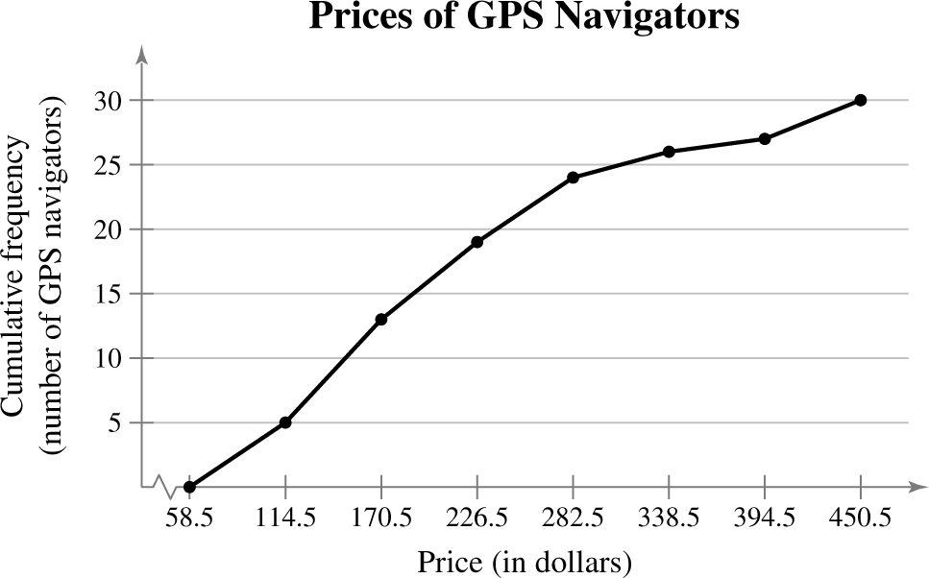
Solution: Ogive
6.5 18.5 30.5 42.5 54.5 66.5 78.5 90.5
From the ogive, you can see that about 25 GPS navigators cost $300 or less. The greatest increase occurs between $114.50 and $170.50.
© 2012 Pearson Education, Inc. All rights reserved.
<number> of 149

Slide 35
Section 2.1 Summary
Constructed frequency distributions
Constructed frequency histograms, frequency polygons, relative frequency histograms and ogives
© 2012 Pearson Education, Inc. All rights reserved.
<number> of 149

